Slide 2
Lab program 7
Build an Artificial Neural Network by implementing the Backpropagation algorithm and test the same using appropriate data sets.
X | Y | class
2 | 9 | 92
1 | 5 | 86
3 | 6 | 89

Slide 3
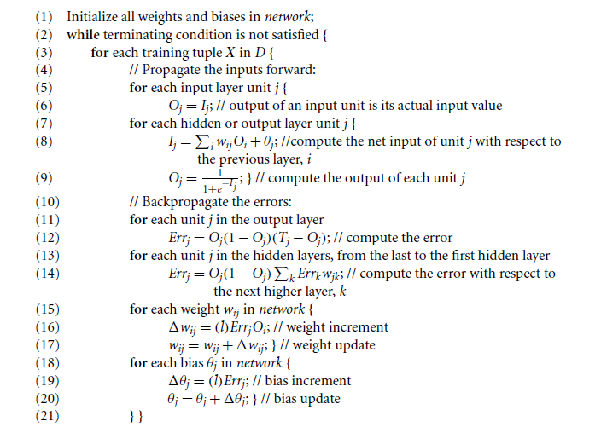
Algorithm

Slide 4
Contd..
Normalize the input values by dividing each value by max value.
Normalize the class label by dividing by 100.
Epochs=5
Learning rate=0.1.
inputlayer_neurons = 2 #number of features in data set
hiddenlayer_neurons = 3 #number of hidden layers neurons
output_neurons = 1

Slide 5
Contd..
Initialize the weights and bias to random values in hidden layer.
Initialize the weights and bias to random values in output layer.
Apply the back propagation algorithm
to find the predicted output for first sample.
If not classify correctly then calculate error and update the weights and bias values of output and hidden layer.
Output the predicted values in each epoch

